Slide 1
Key Indicators

Slide 2
Moving Average Indicators
SMA_5 (Simple Moving Average with a 5 day window)
SMA_10 (Simple Moving Average with a 10 day window)
SMA_15 (Simple Moving Average with a 15 day window)
SMA_30 (Simple Moving Average with a 30 day window)
EMA_9 (Exponential Moving Average with a 9 day window)

Slide 3

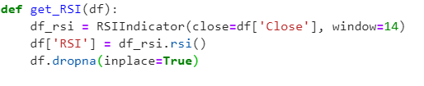

RSI - Relative Strength Index
RSI indicator is used to evaluate overbought or oversold conditions.Iit indicates an oscillation between 0 and 100.
* RSI 70 or above indicates as overbought or overvalued condition.
* RSI 30 or below indicates an oversold condition or undervalued condition.

Slide 4
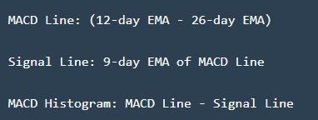
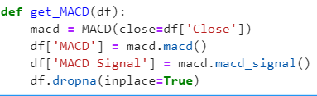
MACD Moving Average Convergence Divergence
MACD shows the relationship between two moving averages.
Moving Average Convergence Divergence is calculated by subtracting the 26-period exponential moving average (EMA) from 12-period EMA.

Slide 5
Models
LSTM
XGBoost Regression
GradientBoosting Regressor
ARMA
ARIMA
AdaBoost Regressor

